Slide 1
COMP1007 Group 1
UNO Game
22239065 Tam Kai Tik
23237767 Wong Tik Shun
21216886 Tsui Tsz Man

Slide 2
The Simulation of the Uno Card Game
A Simplified version of Uno
Players: 2 only ( Player 1 | Player 2 ). No user input.
Cards: 40 in total ( 10 Red | 10 Yellow | 10 Green | 10 Blue ). No function cards.
Number of cards dealt to each player: 5 only.
First card: Random
First player: Random
Playing a card: Players must play a valid card from their hand if they have one. A valid card is a card that matches either the color or the number of the top card on the deck. After playing a card, the player's turn ends.
Drawing a card: If a player does not have any valid card in their hand, they must draw a card from the deck. After drawing a card, the player's turn ends.
End game condition: The game ends when one of the players successfully gets rid of all their cards. If both players cannot play any more cards and there are no available cards left in the deck, the game ends in a tie.

Slide 3
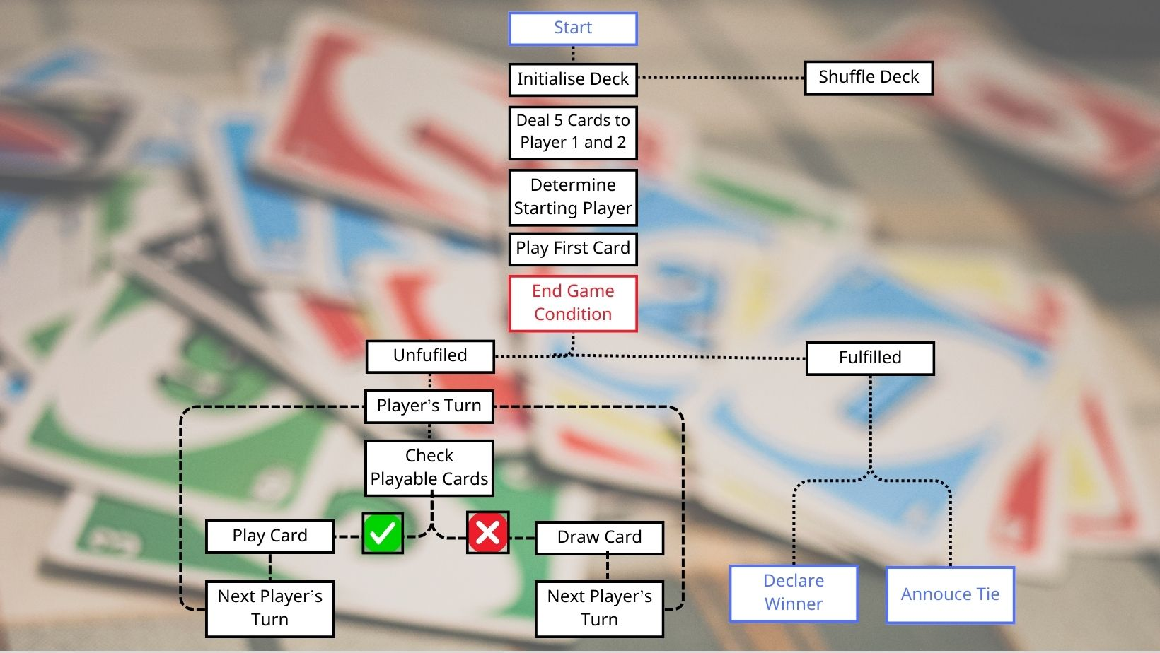
Flow Chart

Slide 4
Enhancement
+ function cards
[draw two, reverse, skip]

Slide 5
The Enhanced Simulation of the Uno Card Game
What are the updates?
Function Cards: 12 Function cards ( 4 Draw two | 4 Reverse | 4 Skip ).
Number of cards dealt to each player: increased to 7 cards.
Last Card: A last card can be a function card (and of course can be a number card)
Other rules: All other descriptions of the game remain the same as the original simulation.
QnA: Do you have any questions regarding the two versions of Uno card game simulations?
Please raise your hands:)

Slide 6
Simulation

Slide 7
Simulation Approach
Basic Model
Enhance 1
Enhance 2
Check is it the game whether is fair game or not
Add two new types of cards
Check is it the game whether is fair game or not
Add three new type of cards
*"Draw cards" would change the fairness of game?

Slide 8
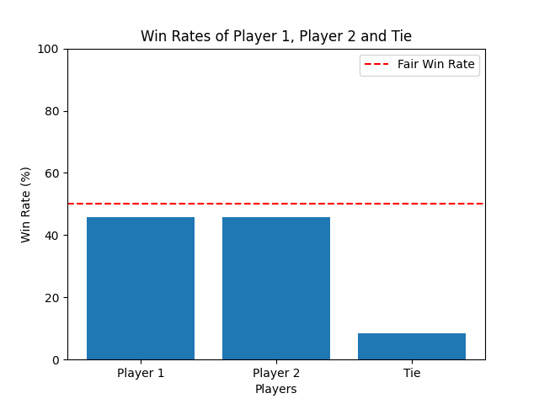
Simulation-Basic
Fair win rate: | 0.5
Player 1 win rate: | 0.46
Player 2 win rate: | 0.45
Tie rate: | 0.08

Slide 9
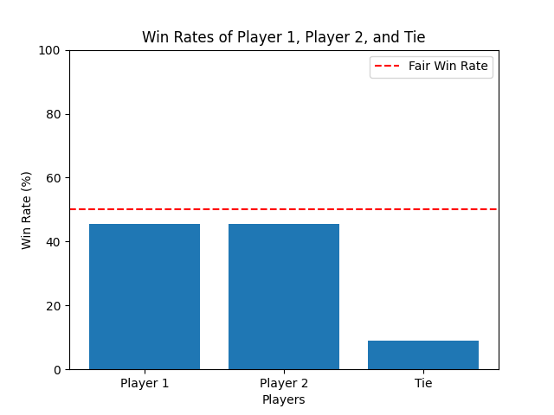
Simulation-Enhancement
Add: Reverse + Skip
Fair win rate: | 0.5
Player 1 win rate: | 0.46
Player 2 win rate: | 0.45
Tie rate: | 0.09

Slide 10
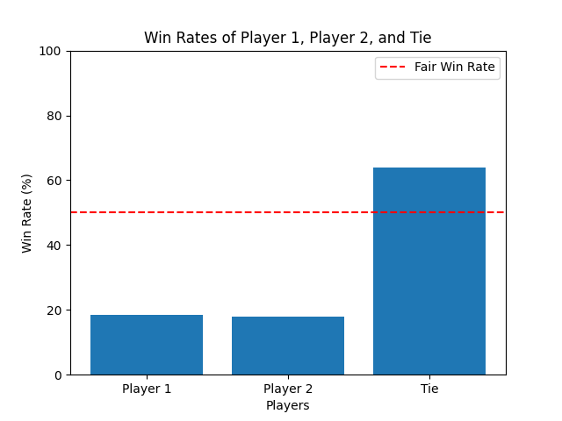
Simulation-Enhancement
Add: Reverse + Skip + Draw two
Fair win rate: | 0.5
Player 1 win rate: | 0.18
Player 2 win rate: | 0.18
Tie rate: | 0.64

Slide 11
Simulation Approach 2
Duration
Go First
Does types of
card affect the duration of the game?
Does player who play first card affect the winning rate

Slide 12
Result
Basic
Enhance 1
Enhance 2
Duration: 30.22
Player1 first: 52.67
Player2 first: 47.32
Duration: 36.50
Player1 first: 53.99
Player2 first: 46.00
Duration: 50.97
Player1 first: 51.6
Player2 first: 48.38

Slide 13
Thanks
Do you have any questions?
addyouremail@freepik.com
+91 620 421 838
yourcompany.com
Please keep this slide for attribution

